Slide 1
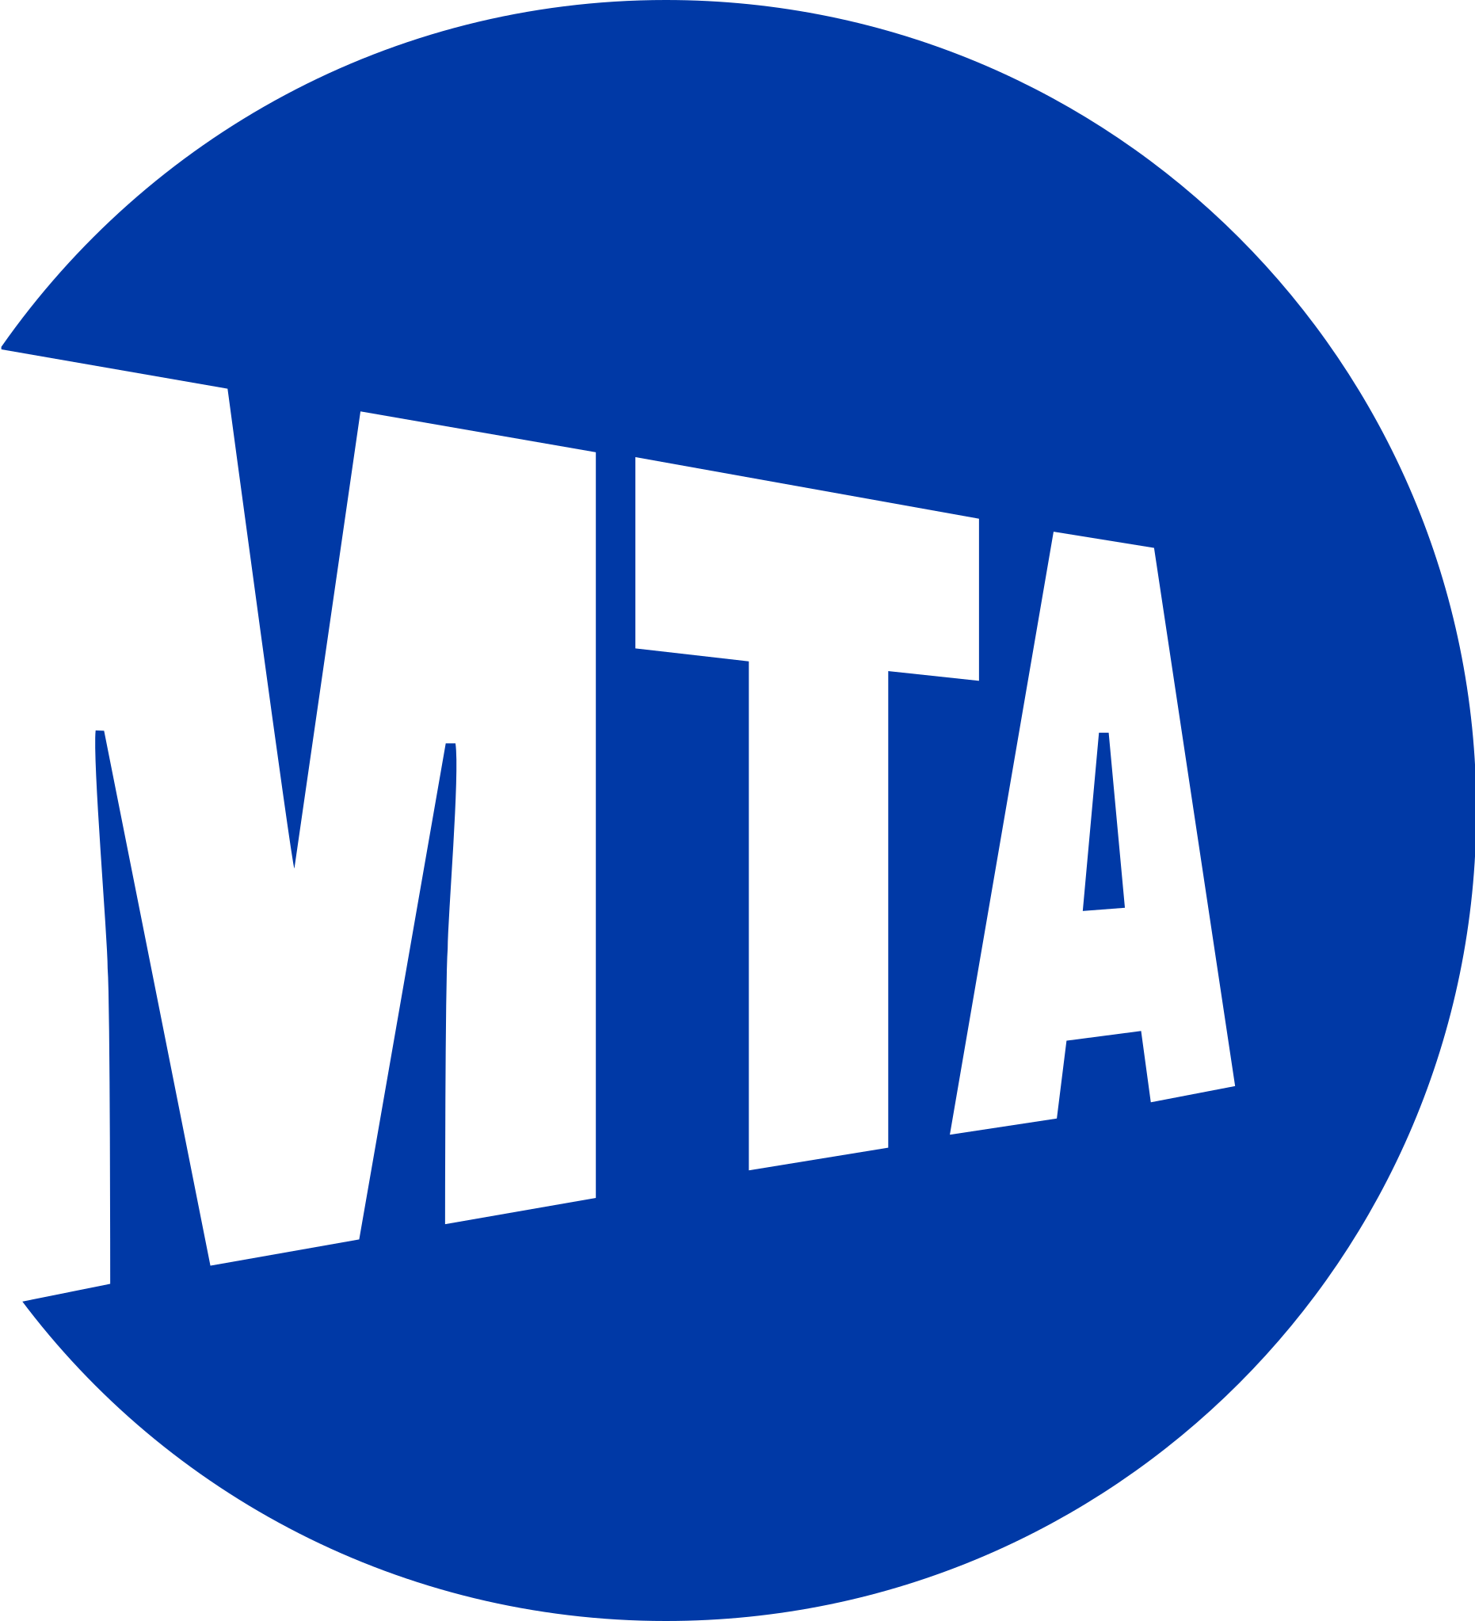
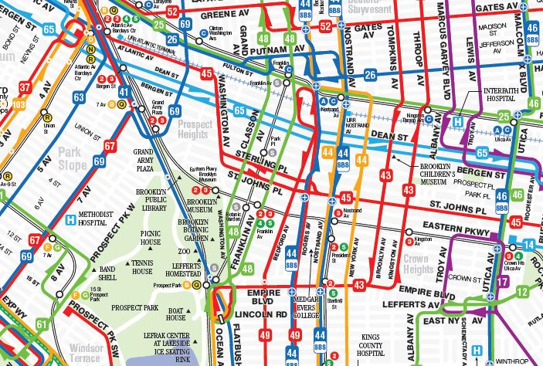
Analyzing MTA Bus Routes & Transit Demand
Tiffany Tran, Megan Alicea, Neil Parsa
Notes:
Tiffany

Slide 2
Our Team
Neil Parsa
CIS Major, Summer 2023 Grad
Megan Alicea
Tiffany Tran
CIS Major, Fall 2023 Grad
CIS Major, Fall 2023 Grad
Notes:
Tiffany

Slide 3

Our Hypothesis
There is a positive correlation between the number of stops near subway stations and the average ridership on different bus routes.
Our company aims to make the lives of New Yorkers easier. Being able to effectively navigate transportation struggles in NYC can give us more time into the day to spend with what matters. To support this goal, we formulated a model suggesting a correlation between the current subway system stops and average ridership on different bus routes throughout the city.
Notes:
Tiffany

Slide 4
Our Audience
MTA & Other Bus Services
NYC Department of Transportation
Transit Apps & Consumers
This is important for the MTA as it allows for effective resource allocation and an enhanced ridership experience. Other bus companies may use this as an opportunity to benefit off where there are gaps in the system to gain a competitive advantage.
This initiative aligns with transportation policy and urban planning for NYC. We could aim to promote seamless transfers between buses and subways, to create a greener and more sustainable urban environment.
Transit apps can integrate our findings to produce real-time information about the best transit routes at a given time. Allowing for the convenience of consumers.
Notes:
Tiffany

Slide 5
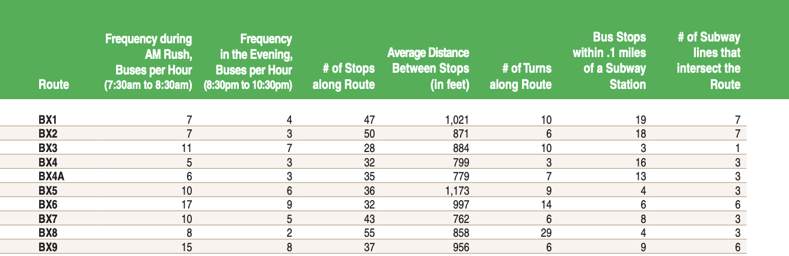
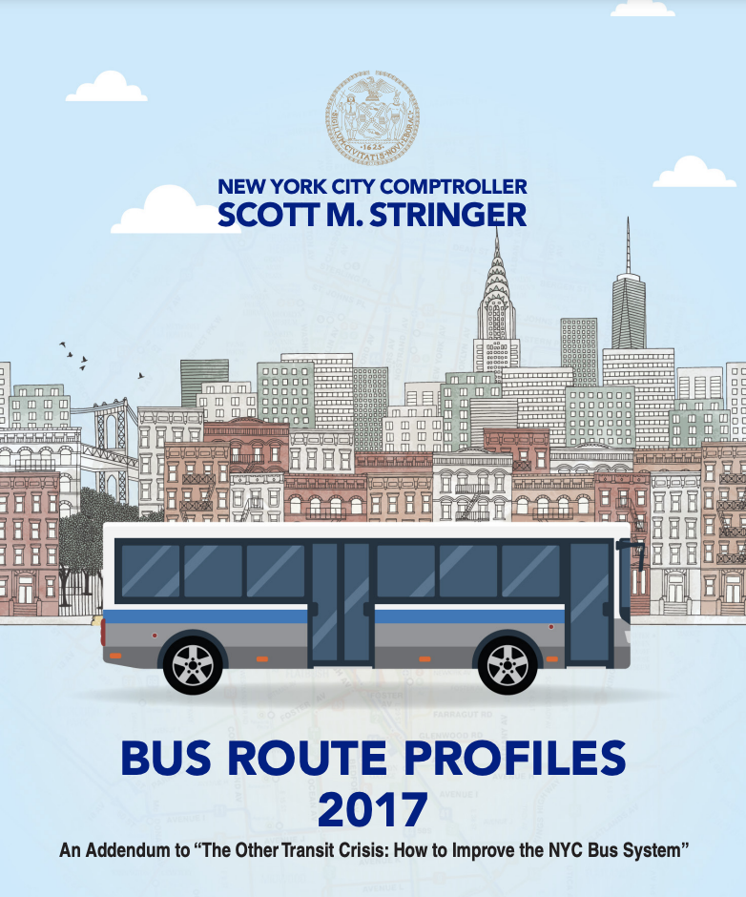
NYC Comptroller Scott M. Stringer’s Bus Routes Profiles 2011 - 2016
“Too many of our bus routes are slow, unreliable, infrequent, and meandering, and too often they are failing to connect working people to where they need to go, when they need to go. Meanwhile, the bus fleet is old, bus shelters are deficient, and many innovations that could help to speed up buses are being implemented slowly or not at all, leading to a decline in ridership of over 100 million in the last eight years alone.
These “Bus Route Profiles” help you see how buses in your neighborhood are doing. It analyzes the ridership, speed, frequencies, and interconnectivity of every route, providing an important resource to communities throughout the city”
Notes:
What data did we mine?
Neil

Slide 6
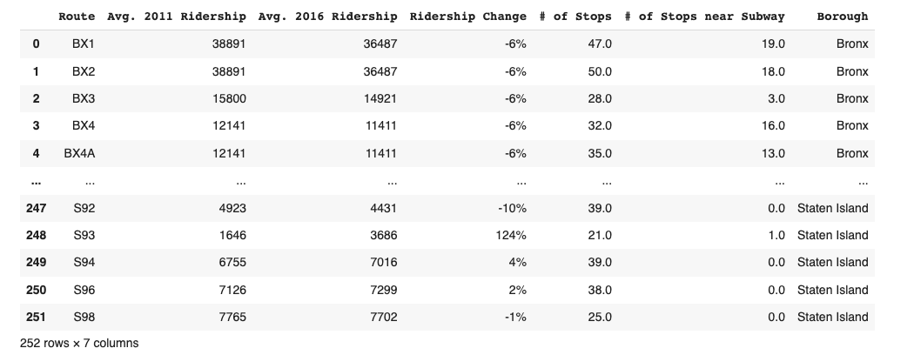
Data Preparation
Features:
Route
Average 2011 Ridership
Average 2016 Ridership
Average Ridership % Change
Number of Bus Stops Along Route
Number of Bus Stops near Subway
Borough
Shape:
(252 Rows, 7 Columns)
Notes:
Neil

Slide 7
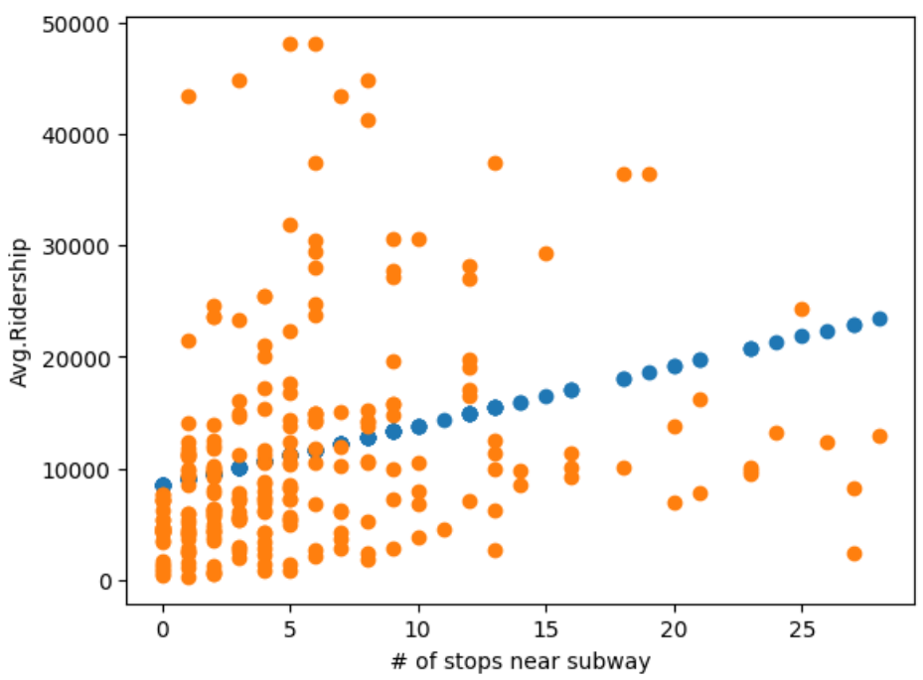
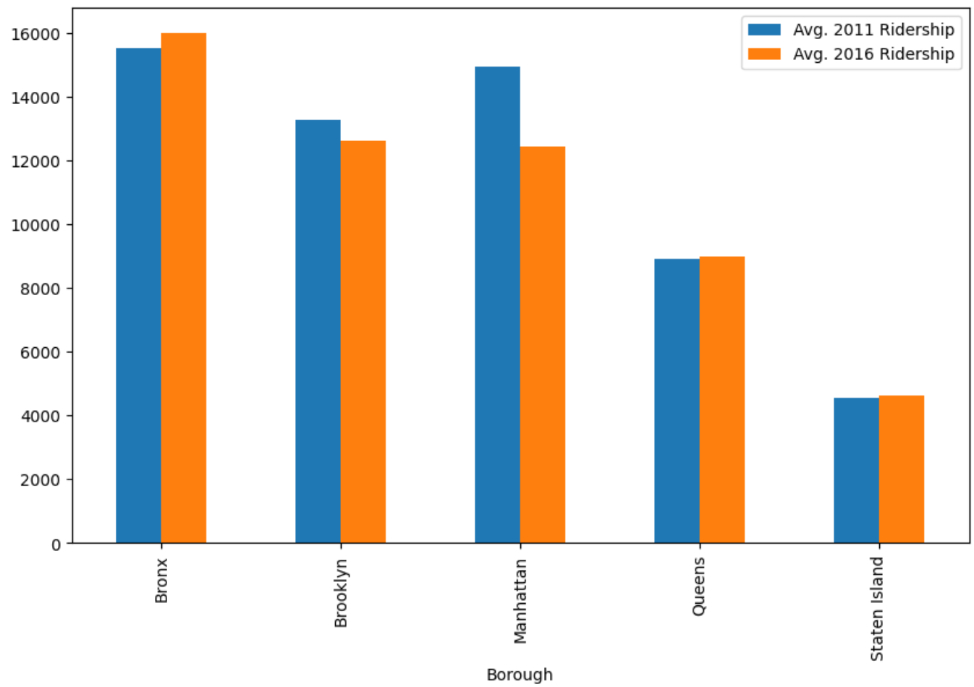
Data Modelling: Linear Regression
Coefficient of Determination: .09086
Y = 534.38x + 8481.17
Notes:
Neil

Slide 8
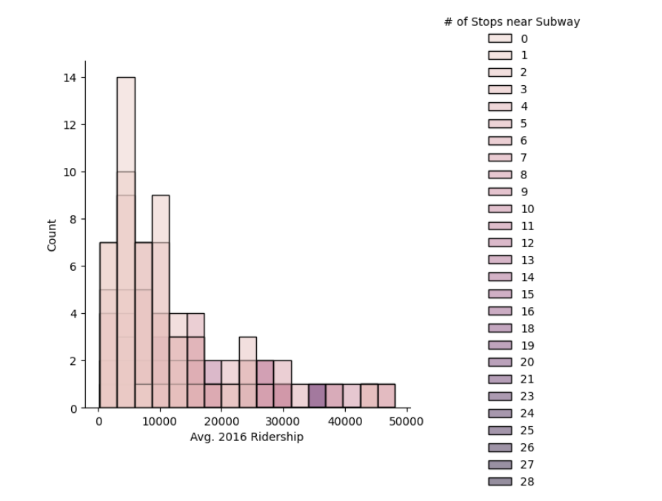
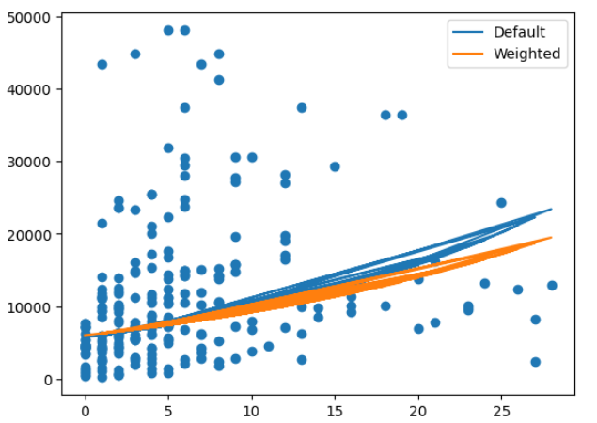
Data Modelling: Logarithmic Regression
Notes:
Neil

Slide 9
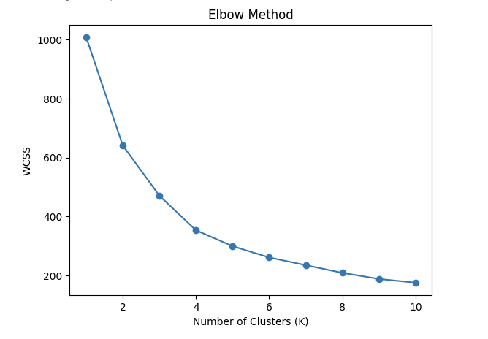
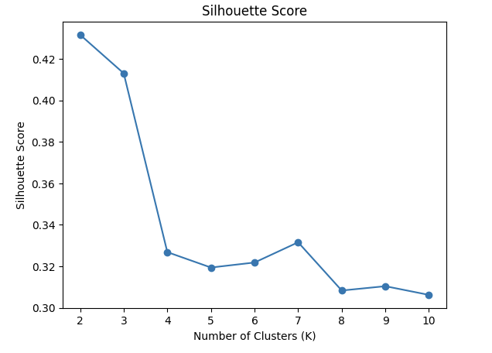
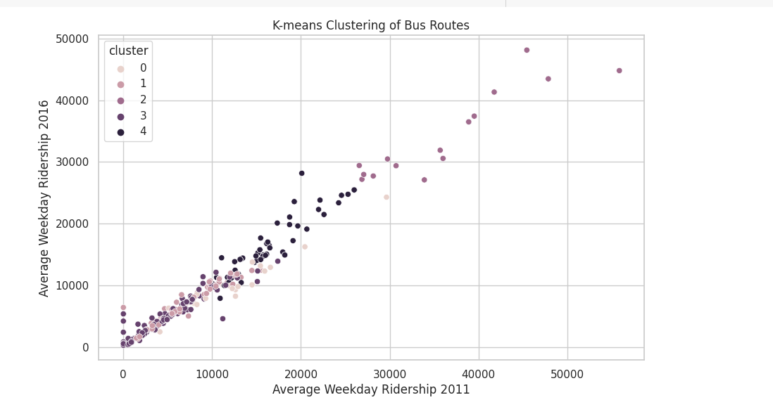
Data Modelling: K-Means Clustering
Hyper-Parameter Tuning
Applying the Model with K = 5
Notes:
Megan

Slide 10
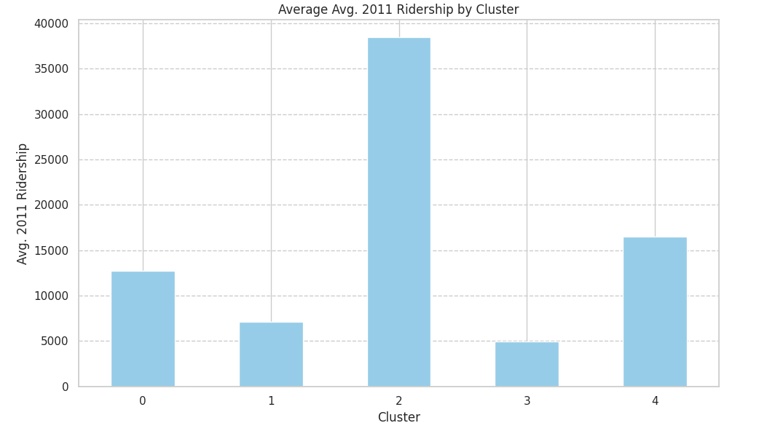
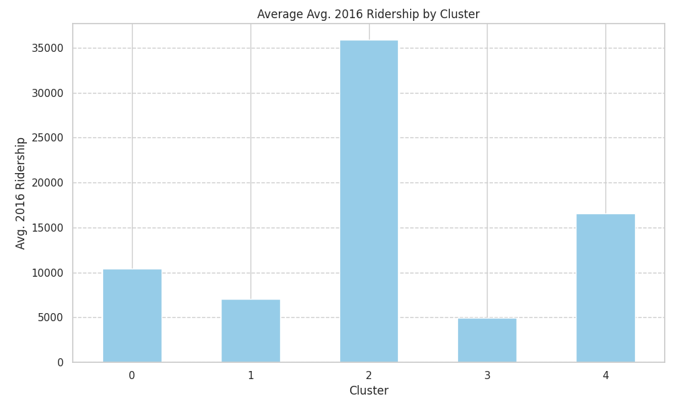
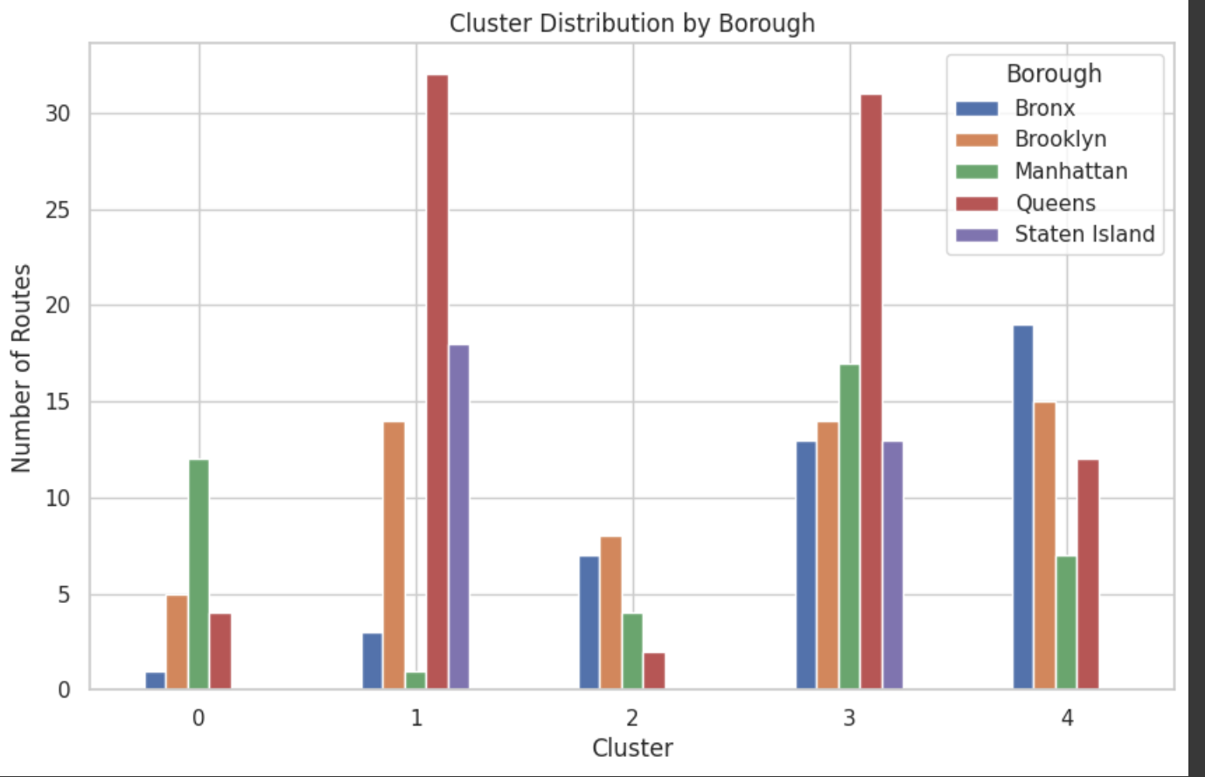
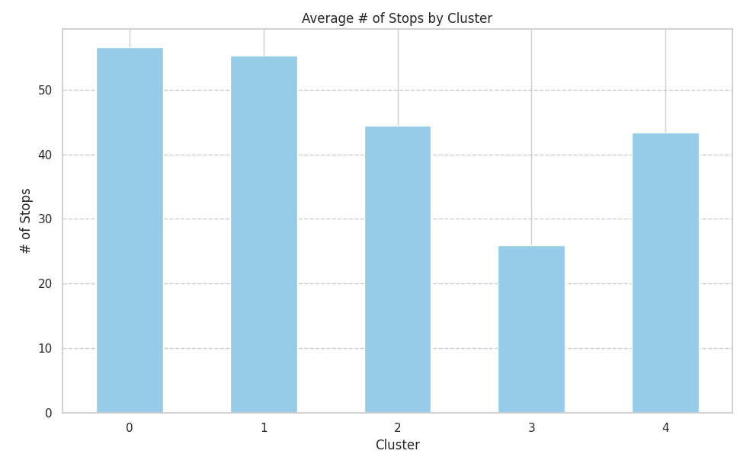
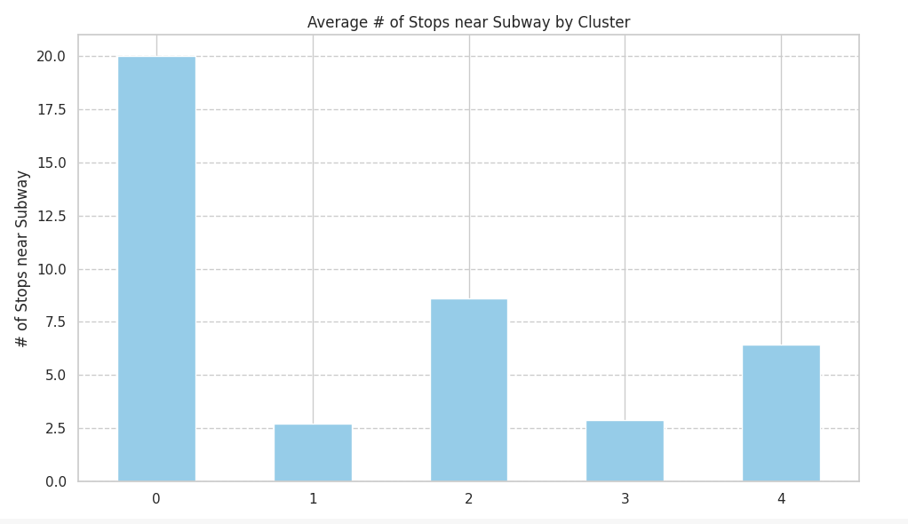
Data Modelling: Clustering (Con’t)
Exploring Clustering Characteristics
Model Evaluation: Silhouette Score: .3194 Inertia: 299.38
Notes:
Megan

Slide 11
Application of Insights
Hypothesis: There is a positive correlation between the number of stops near subway stations and the average ridership on different bus routes
Findings:
Main region groups to consider:
↓ ridership, ↑ stops along route, ↓ stops near subway station
Queens, Staten Island
Room for improvement
Feature engineering
Variety in bus route characteristics
Notes:
Megan

Slide 12
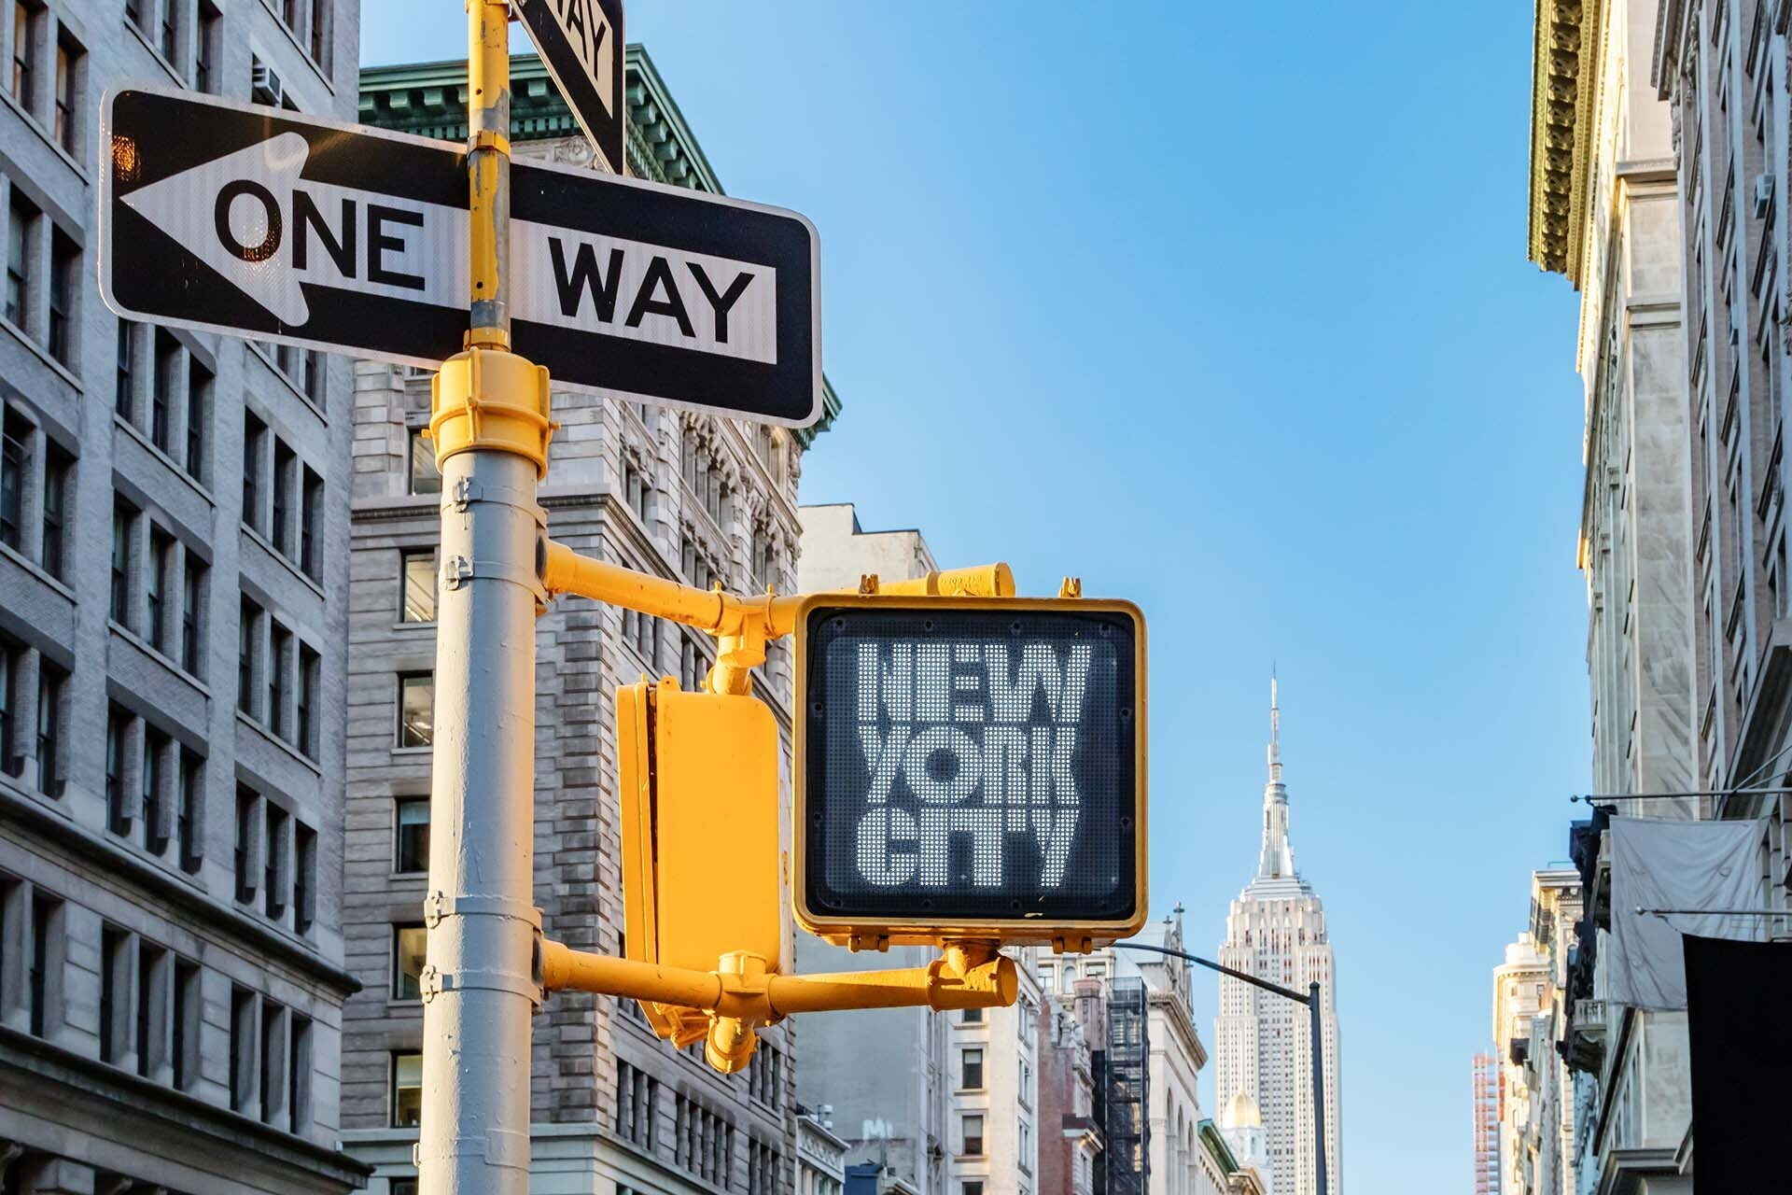
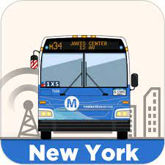
Thank you!

